Slide 1

DBMS
Lab-2

Slide 2
SQL
•
•
•
•
•
•
SQL( Structured Query Language) is the standard language for relational
database
IBM developed the original version of SQL in early 1970s, with name
Sequel
In 1986, the ANSI & ISO published the SQL standard, SQL-86
ANSI published extended standard, SQL-89 in 1989
Next versions are SQL-92, SQL-1999, SQL-2003
SQL is the ideal database language to
• Create database and table structures
• Perform basic data management operation
• Perform complex queries to transform data into useful information

Slide 3
SQL Statements
Select | DQL (Data Query Language)
Create Alter Drop Rename Truncate | DDL ( Data Definition Language)
Insert Update Delete | DML(Data Manipulation Language)
Commit Rollback Save point | TCL( Transaction Control Language)
Grant Revoke | DCL ( Data Control Language)

Slide 4
Viewing the Table Structure
DESC table_name;
DESCRIBE table_name;
Ex: DESC employees;

Slide 5
SELECT : To retrieve the data/records from the database as per the given query.
Syntax :
Select [distinct ] { */ column_name(s) from TableName }
[ Where { condition } ]
[ Group By ( column_name(s))]
[Having ( condition) ]
[Order by (Column_name(s)) [desc]];

Slide 6
Some SQL Commands.. Using Select
Select * from <Table_name> :
To List all the records of table.
Example:
Select * from tab;
Select * from employees;

Slide 7
Some SQL Commands.. Using Select
Select Col1,col2,col3.. From <Table name> :
To List specified columns from the table.
Example:
Select First_name, salary from employees;

Slide 8
Some SQL Commands.. Using Select
Select * from <table name> Where <condition> :
To list only the condition satisfied records.
Example:
Select * from employees where salary>7000;
Select * from Employees where department_id =10;

Slide 9
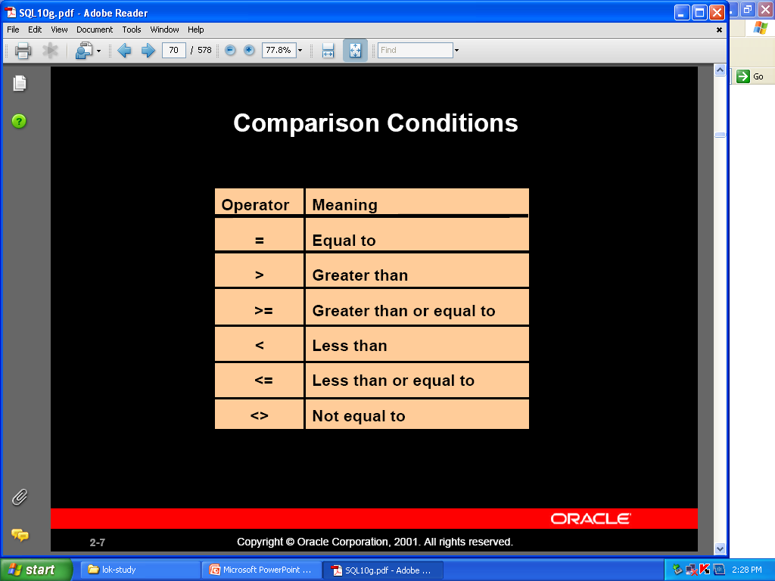

Slide 10
Operators used to specify the Condition
• Relational Operators
• =
• >
• <
• >=
• <=
• <> or !=
• ANY
• ALL
ex: CGPA=9.0
ex: Age>20
ex: Age<20
ex: Age>=20
ex: Age<=20
ex: Name !=‘Hari’
ex: Age > ANY(20,23,19)
ex: Age > ALL(20,18)

Slide 11
• Logical Operators
• AND
• OR
• NOT
ex: City=‘Bhubaneswar’ AND Age=20
ex: City =‘Bhubaneswar’ OR Age=20
ex: NOT(Age=20 OR Age=21)
AND has more precedence than OR

Slide 12
• Special Operators
• IN
• BETWEEN AND
• LIKE
ex: City IN(‘Delhi’,’Cuttack’,’Ranchi’)
ex: Age BETWEEN 20 AND 22
ex: Name LIKE ‘S%’
Name LIKE ‘S____’
Name LIKE ‘%i%’
Name LIKE ‘_i%’

Slide 13
Use of (and , or , not )
Examples :
Select * from employees where First_name= ‘Alex ‘ and salary >10000
Select * from employees
where department_id =10 and salary >=20000
Select * from employees
where department_id = 10 or salary >= 10000
Select * from employees
where Commission_pct is not null

Slide 14
Use of Between…. And.. Operator
Select * from employees
where salary between 10000 And 25000
Select * from employees
where hire_date between ‘12-aug-1987’ And ‘ 01-jan-2000’

Slide 15
Use of in Operator
Select * from employees
where salary in ( 10000 , 17000, 24000)
Select * from departments
where department_id in ( 10, 20, 30)

Slide 16
Displaying Distinct Rows
Select Distinct column_name(s) From
<Table_name>;
Example:
Select department_id From employees;
Select Distinct department_id From employees;

Slide 17
Using Expressions with Columns
• SELECT column, expression FROM tablename;
• select salary, salary+100 from employees;
SALARY | SALARY+100
24000 | 24100
17000 | 17100
17000 | 17100
9000 | 9100
6000 | 6100
4800 | 4900
4800 | 4900
4200 | 4300
12000 | 12100
9000 | 9100

Slide 18
Use of Alias To The Column
SELECT column1,column2 [AS] Alias FROM tablename;
Select salary, salary+100 as IncSalary from employees;
SALARY | IncSalary
24000 | 24100
17000 | 17100
17000 | 17100
9000 | 9100
6000 | 6100
4800 | 4900
4800 | 4900
4200 | 4300
12000 | 12100
9000 | 9100

Slide 19
Merging Column Output using
Concatenation
SELECT column1||’’||column2 AS ALIAS FROM table_name;
Example:
select first_name||’ '||Last_name As FullName from employees;

Slide 20
Working With NULL Values
• SELECT columns FROM tablename WHERE column is
NULL;
• Select First_name, Commission_pct
from employees where
Commission_pct is null;

Slide 21
NVL(column, substituted value)
SELECT commission_pct,
NVL(Commission_pct, 0)
FROM
Employees;

Slide 22
Sorting Rows Using ‘ORDER BY’ Clause
• SELECT columns FROM tablename [WHERE condn]
ORDER BY column [ASC/DESC];
• SELECT * FROM employees ORDER BY salary;
• SELECT * FROM employees ORDER By salary, department_id
DESC;
NULL values come at the end of the table in case of
ORDER BY clause

Slide 23
Ordering Rows By Column Number
• SELECT columns FROM tablename [WHERE condn] ORDER BY columnno [ASC/DESC];
• SELECT * FROM employees ORDER BY 3;

Slide 24
Thank You

